Slide 1


Dash camera based real time video assisted driving tools
Dibyanshu Patnaik - E024
Harsh Praharaj - E027
Kartikeya Prakash - E028
Avi Seth - E038
Dr. Pravin Shrinath
NMIMS MPSTME
COMPUTER VISION
7th February 2020

Slide 2
OUTLINE
Introduction
Problem definition
Literature review in brief (2 slides)
Analysis & Design
Implementation
Action plan for rest of the Project
Conclusion & Future work
References
Notes:
Insert a map of your country.

Slide 3
INTRODUCTION
“DRIVING AID SYSTEM
Focus is now on real time object identification from non - stationary low resolution input sources
Building up on the research done in the previous semester so as to have an application oriented approach
Notes:
Insert a picture of one of the geographic features of your country.

Slide 4
COMPONENTS OF THE SYSTEM
VEHICLE DETECTION
DRIVER DROWSINESS DETECTION
TRAFFIC SIGN CLASSIFIER
LANE DETECTION
Yolo V3
KITTI Dataset
Custom trained model
Pre trained model for benchmarking
GPU less implementation
Novel linear formula
Very basic dataset
Opencv based implementation
HSL
Gaussian Blur
Canny Edge Detection
Hough Transform
Separate left and right lanes
Notes:
Insert a picture of one of the geographic features of your country.

Slide 5
TRAFFIC SIGN CLASSIFIER

Slide 6
LANE DETECTION
Convert original image to HSL
Isolate yellow and white from HSL image
Combine isolated HSL with original image
Convert image to grayscale for easier manipulation
Apply Gaussian Blur to smoothen edges
Apply Canny Edge Detection on smoothed gray image
Trace Region Of Interest and discard all other lines identified by our previous step that are outside this region
Perform a Hough Transform to find lanes within our region of interest and trace them in red
Separate left and right lanes
Interpolate line gradients to create two smooth lines
Notes:
Insert a picture of one of the geographic features of your country.

Slide 7
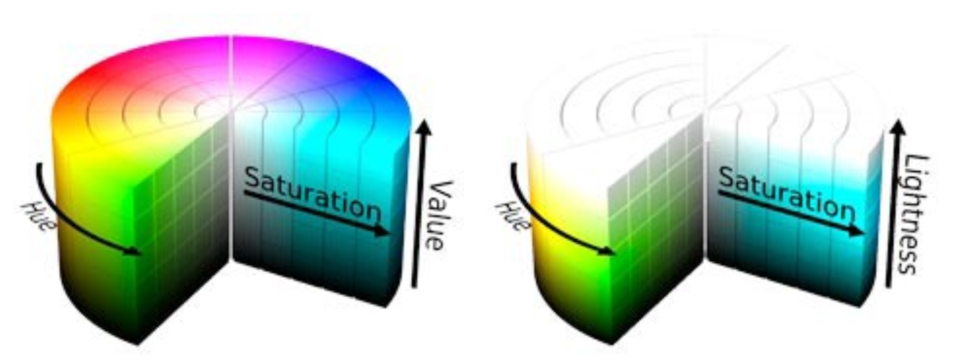
LANE DETECTION - HSL
Hue
Saturation
Lightness
Notes:
Insert a picture of one of the geographic features of your country.

Slide 8
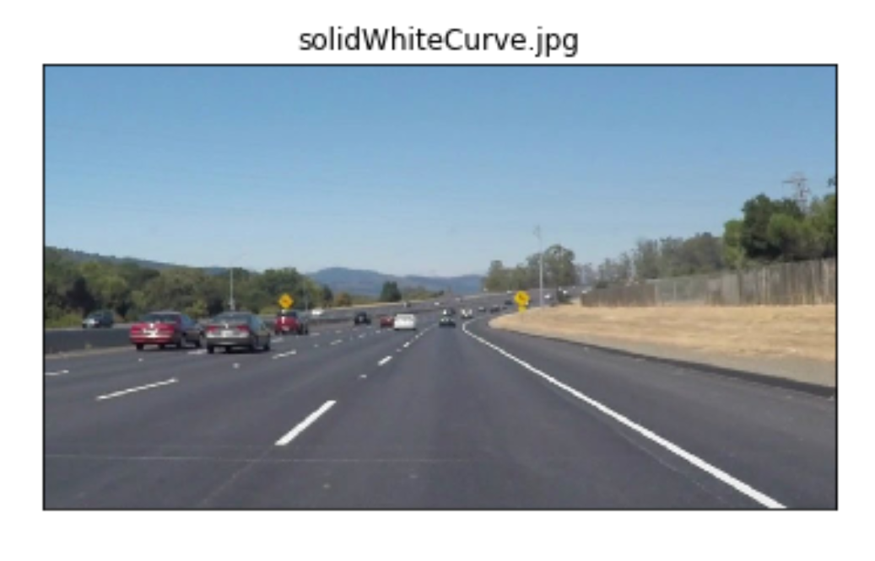
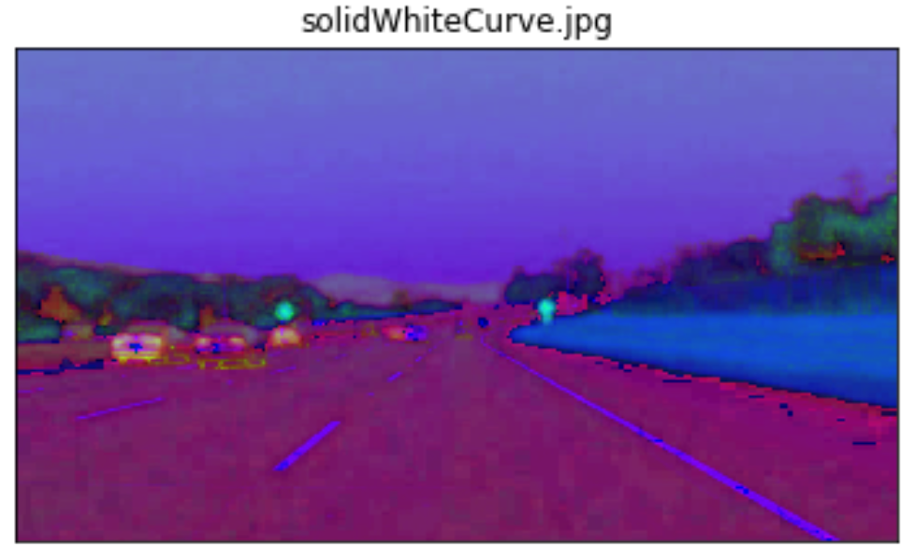
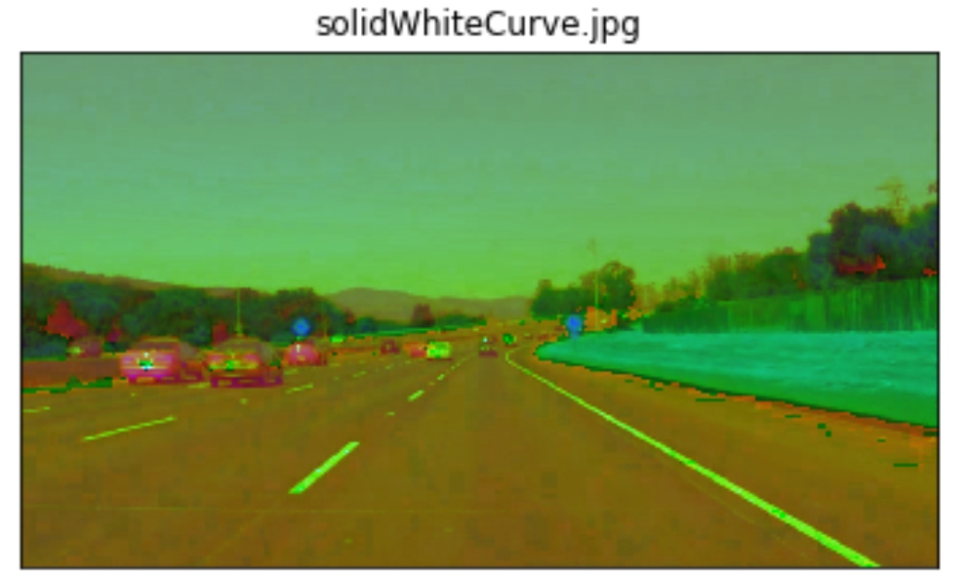
LANE DETECTION - HSV vs HSL
ORIGINAL
cv2.cvtColor(img, cv2.COLOR_RGB2HSV)
cv2.cvtColor(img, cv2.COLOR_RGB2HLS)
Notes:
Insert a picture of one of the geographic features of your country.

Slide 9
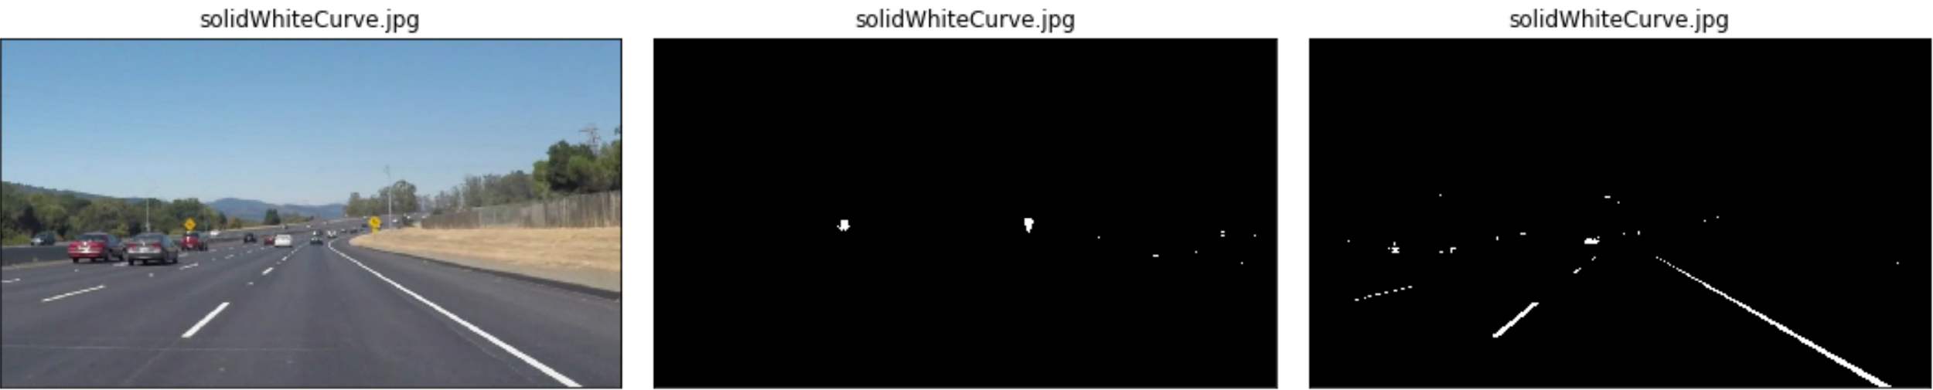
LANE DETECTION -
ISOLATING YELLOW AND WHITE
low_threshold = np.array([15, 38, 115])
high_threshold = np.array([35, 204, 255])
yellow_mask = cv2.inRange(img, low_threshold, high_threshold)
low_threshold = np.array([0, 200, 0])
high_threshold = np.array([180, 255, 255])
white_mask = cv2.inRange(img, low_threshold, high_threshold)
Notes:
Insert a picture of one of the geographic features of your country.

Slide 10
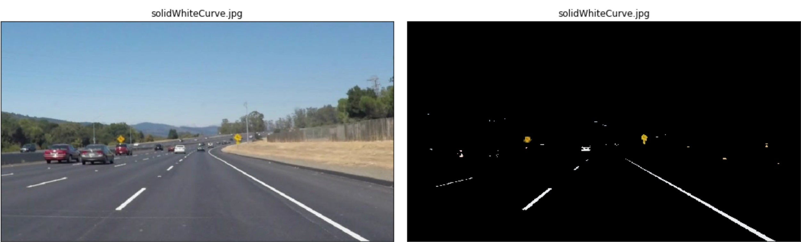
LANE DETECTION - COMBINING THE FRAMES
Combine those two masks using an OR operation and then combine with the original image using an AND operation to only retain the intersecting elements.
hsl_mask = cv2.bitwise_or(hsl_yellow, hsl_white)
output_mask = cv2.bitwise_and(img, img, mask=hsl_mask)
Notes:
Insert a picture of one of the geographic features of your country.

Slide 11
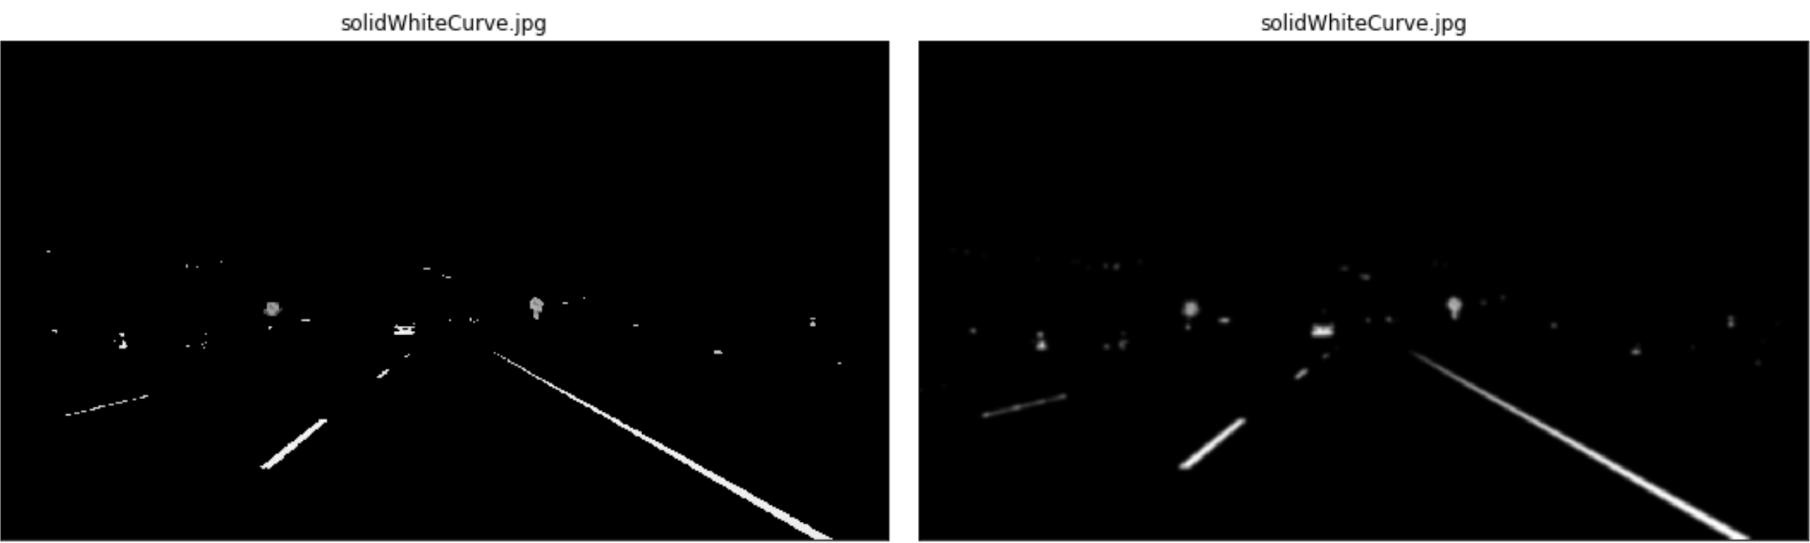
LANE DETECTION -
GRAY SCALE AND GAUSSIAN BLUR
cv2.cvtColor(img, cv2.COLOR_RGB2GRAY)
cv2.GaussianBlur(grayscale_img, (kernel_size, kernel_size), 0)
compared kernel size 5, 11, 21; and settled on 11 as it gave optimum output
Notes:
Insert a picture of one of the geographic features of your country.

Slide 12
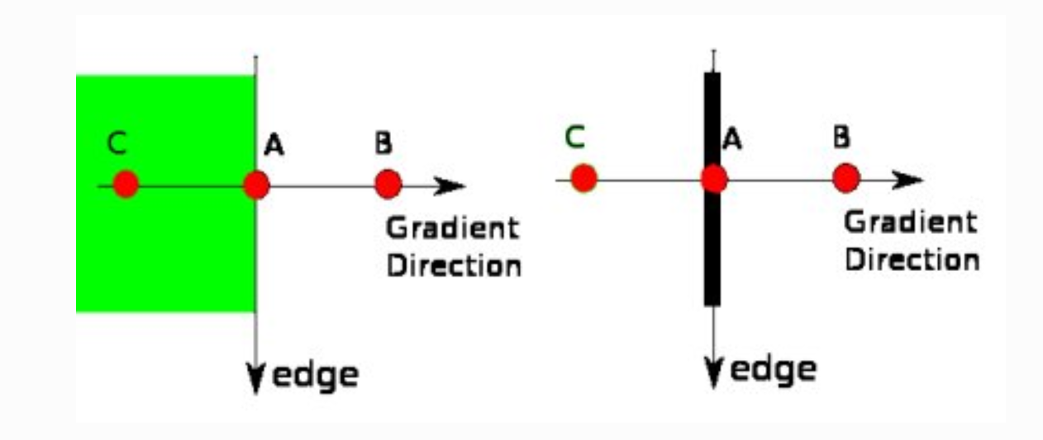
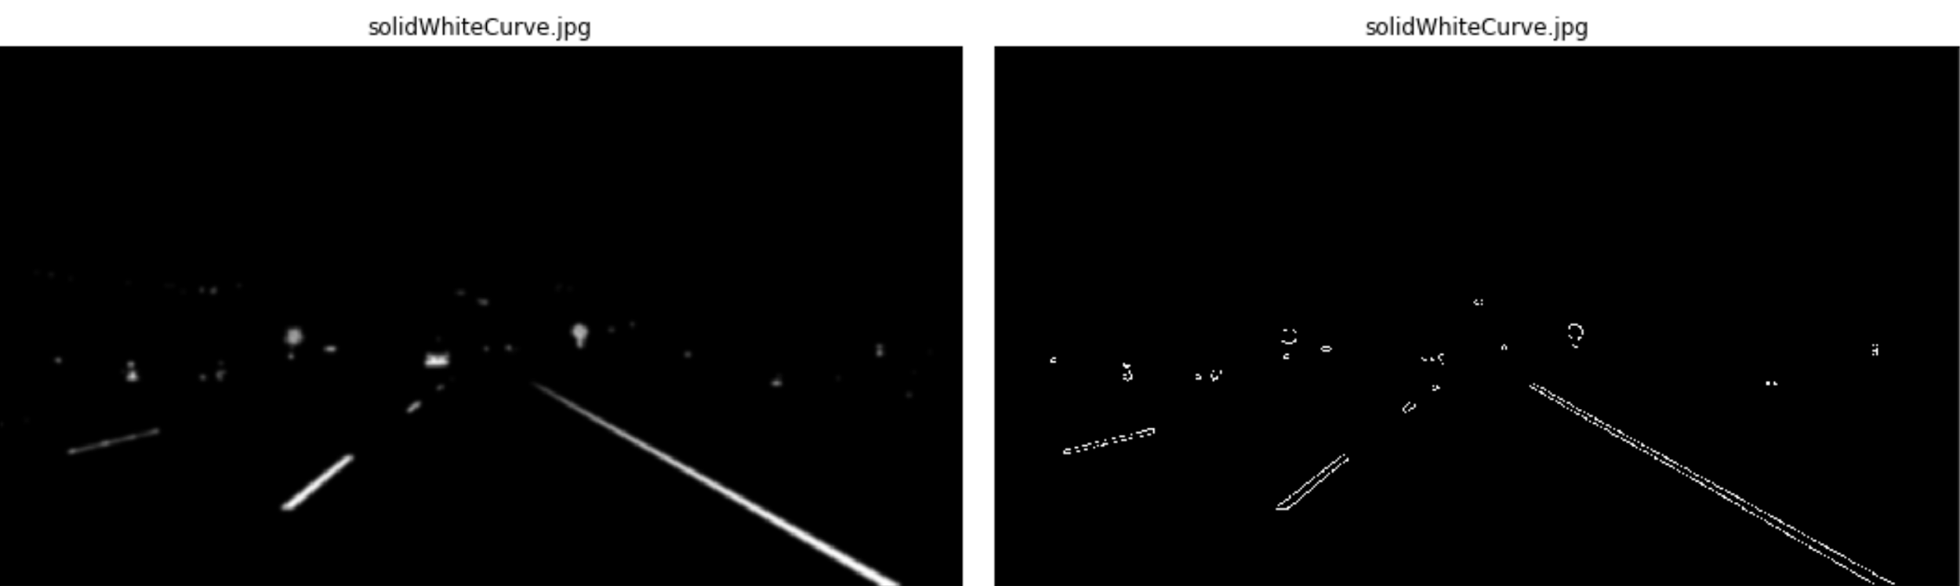
LANE DETECTION -
CANNY EDGE DETECTION
Intensity Gradient
Image smoothening with Sobel kernel
Find edge gradient and direction for each pixel
Non Maximum Suppression
pixels are checked if they’re the local maxima
A is on edge, hence gradient direction is normal to the edge
Point B and C are in gradient directions.
So point A is checked with point B and C to see if it forms a local maximum. If so, it is considered for next stage, otherwise, it is suppressed ( put to zero).
Notes:
Insert a picture of one of the geographic features of your country.

Slide 13
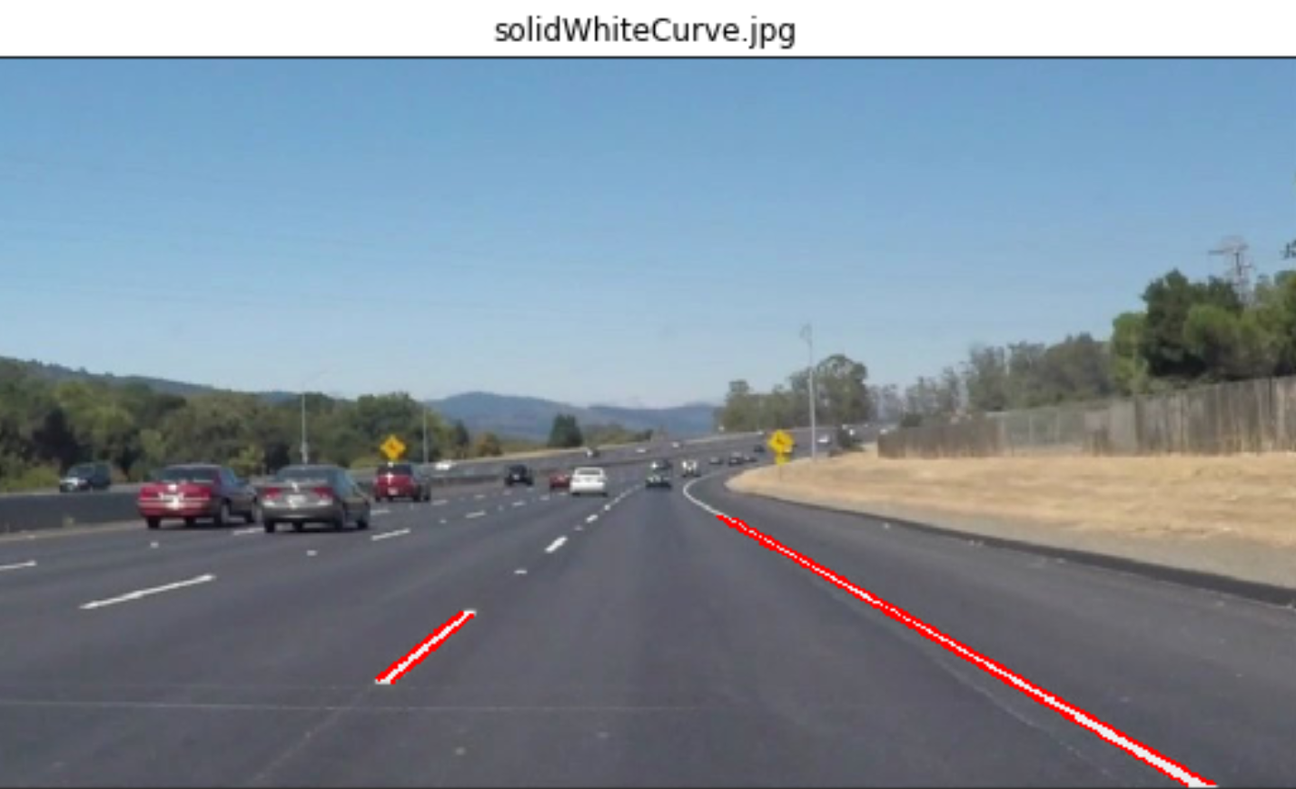
LANE DETECTION -
HOUGH TRANSFORM
Notes:
Insert a picture of one of the geographic features of your country.

Slide 14
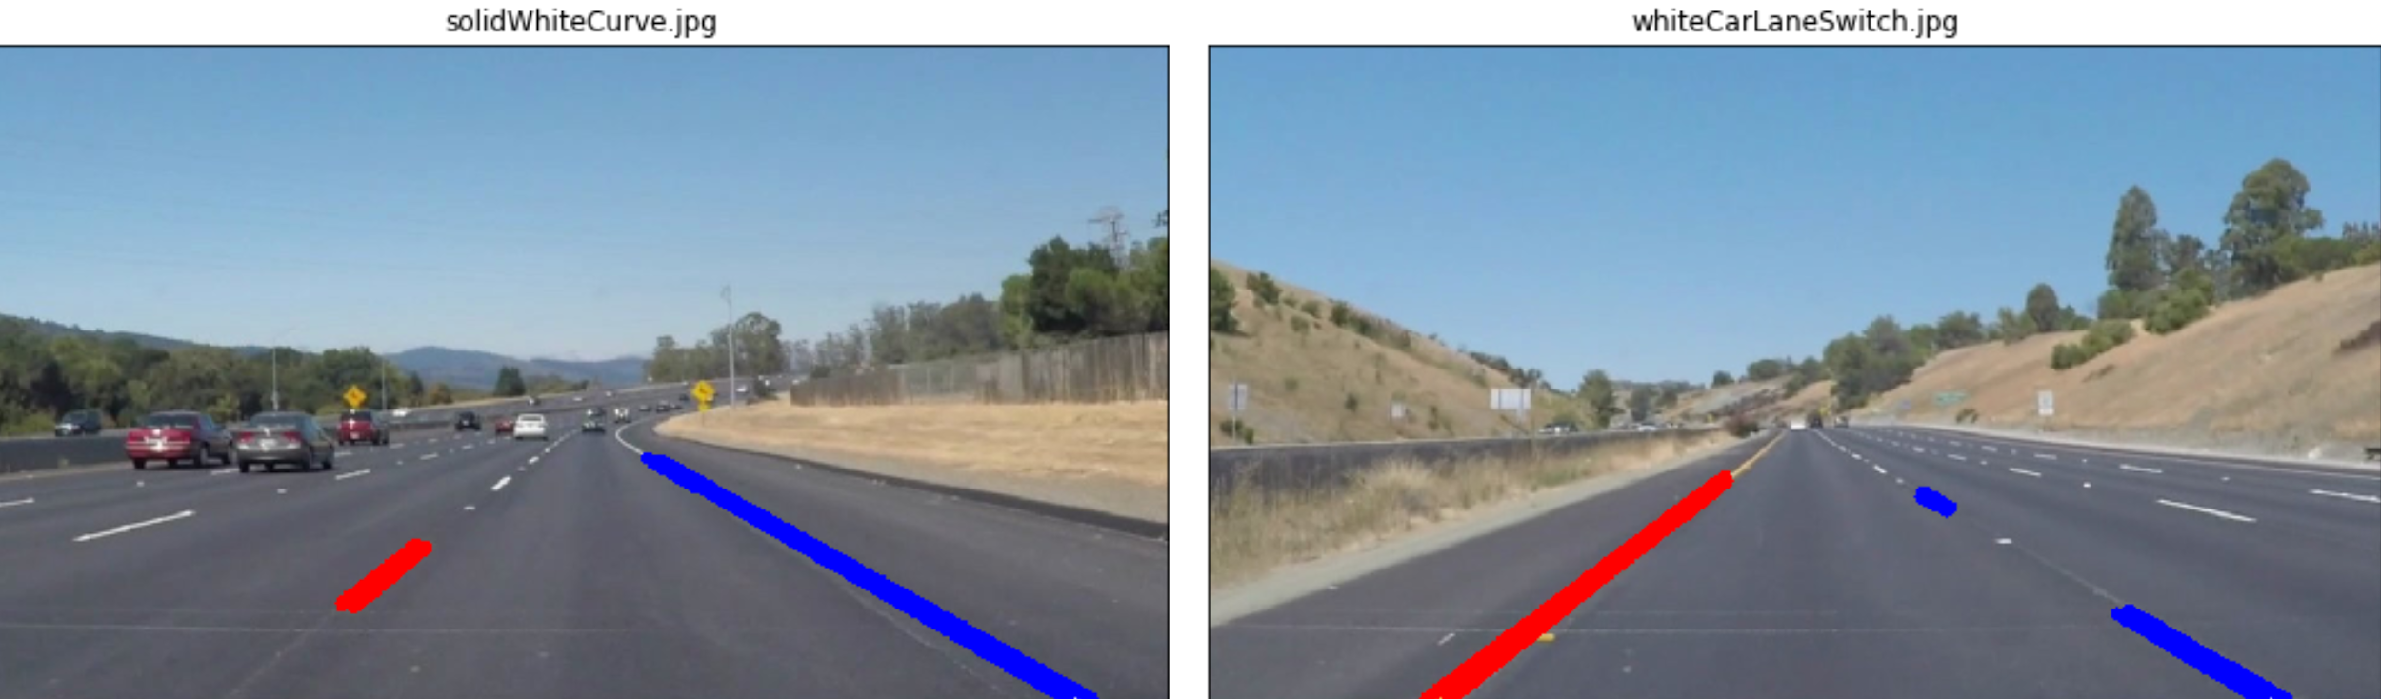
LANE DETECTION -
SEPARATING LEFT AND RIGHT LANES
Notes:
Insert a picture of one of the geographic features of your country.

Slide 15
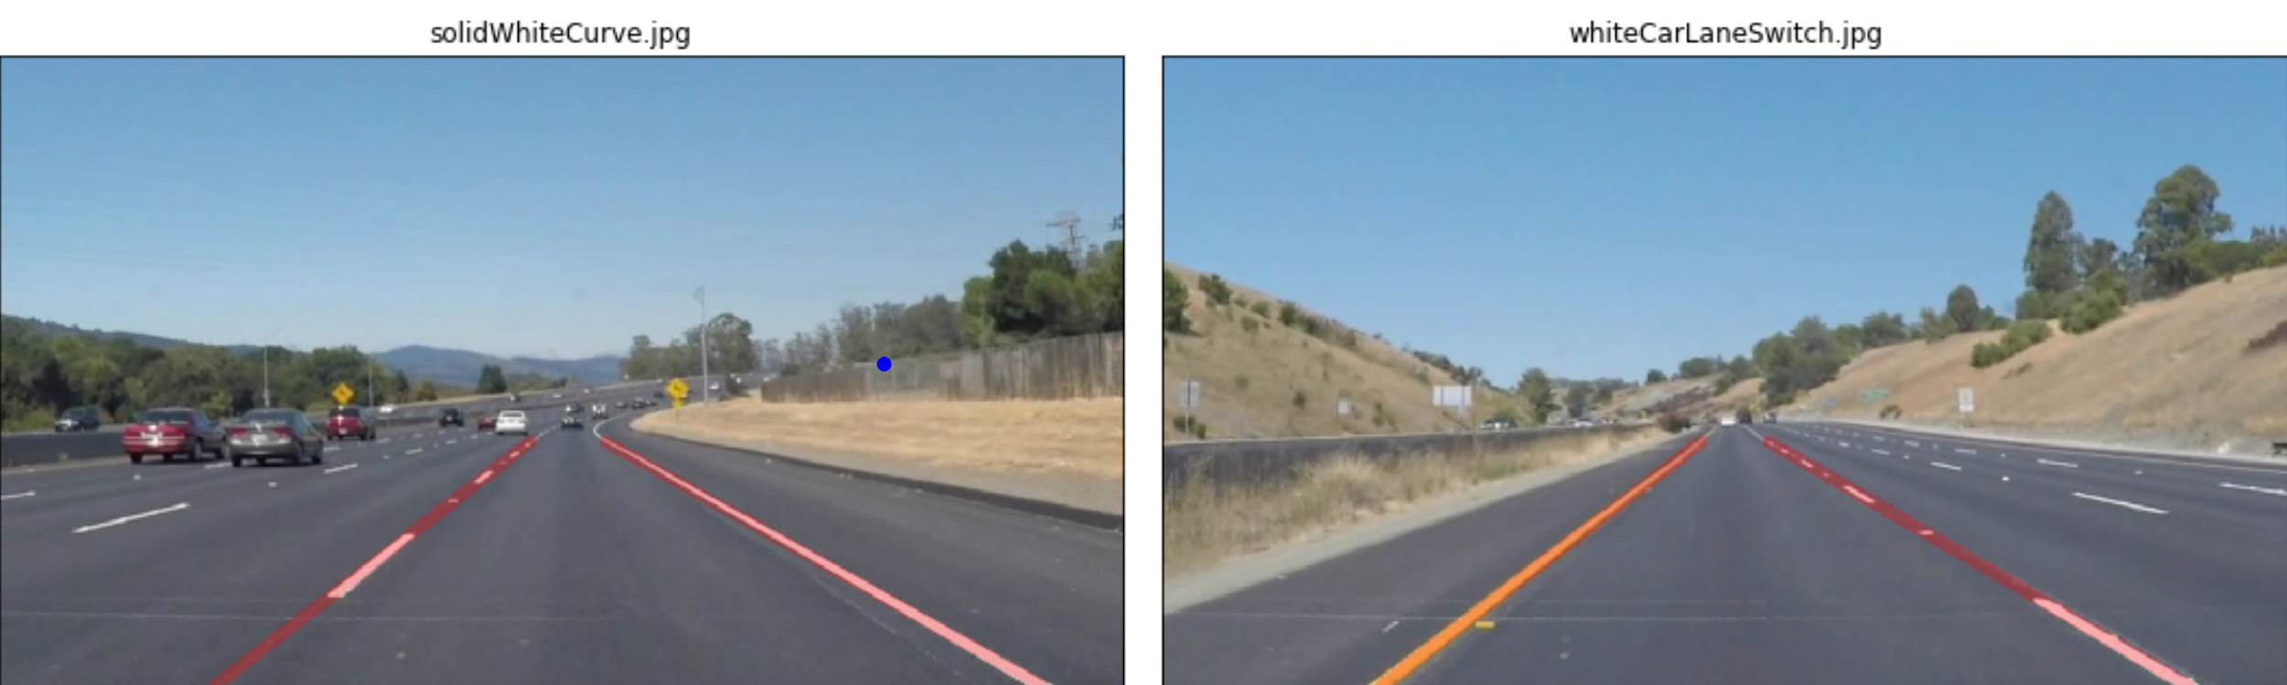
LANE DETECTION -
REGRESSION BASED EXTRAPOLATION
Notes:
Insert a picture of one of the geographic features of your country.

Slide 16
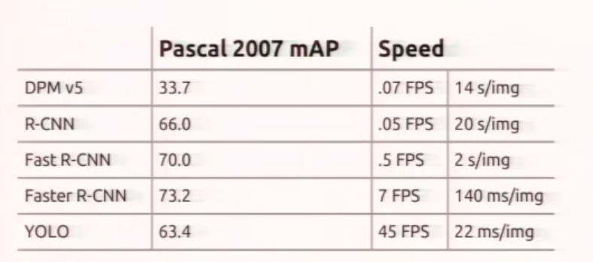
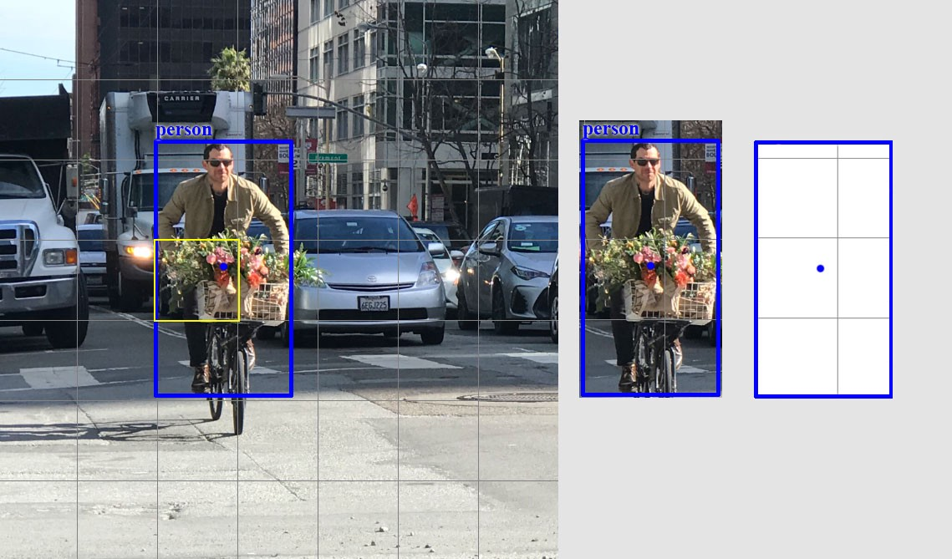
OBJECT RECOGNITION YOLO
-> Real time detection
-> Less accurate but WAY faster than other methods
-> Not repurposed
-> Bounding box locates AND identifies
Notes:
Insert a picture of one of the geographic features of your country.

Slide 17
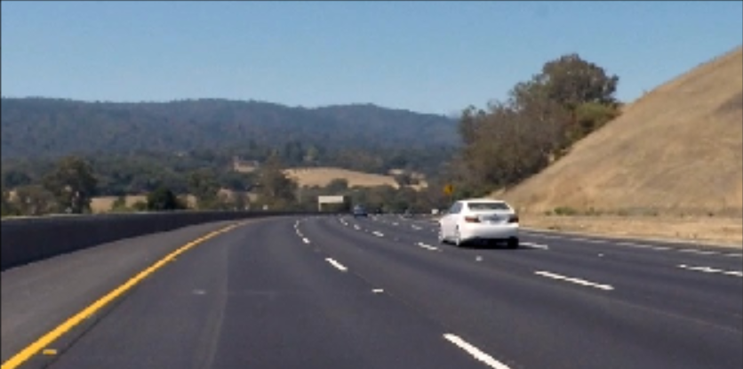
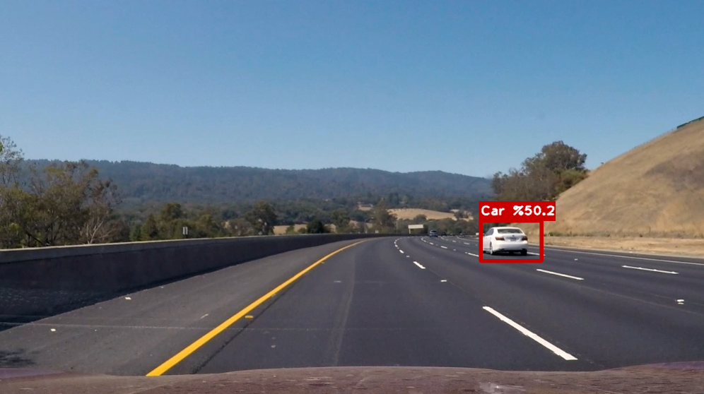
YOLO
Notes:
Insert a picture of one of the geographic features of your country.

Slide 18
DROWSINESS DETECTION
A computer vision system that can automatically detect driver drowsiness in a real-time video stream and then play an alarm if the driver appears to be drowsy.
Dependencies:
cv2, imutils, dlib, scipy, pyglet
Notes:
Insert a map of your country.

Slide 19
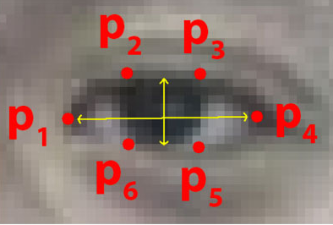
ALGORITHM
Each eye is represented by 6 (x, y)-coordinates, starting at the left-corner of the eye, and then working clockwise around the eye:
It checks 20 consecutive frames and if the Eye Aspect ratio is less than 0.25, Alert is generated.
Notes:
Insert a map of your country.

Slide 20
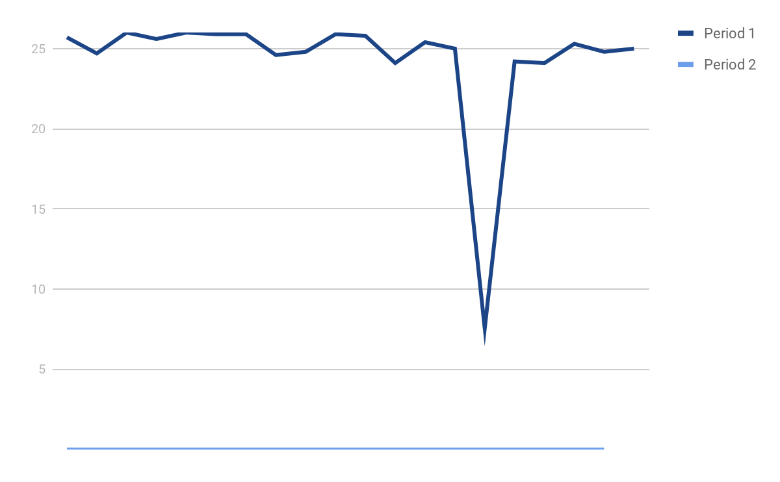
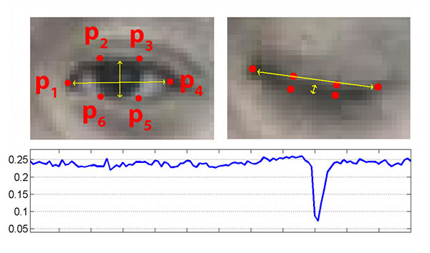
ALGORITHM
Eye Aspect Ratio: EAR = ‖P2 - P6‖+‖P3 - P5‖
2*‖P1 - P4‖
Notes:
Insert a map of your country.

Slide 21
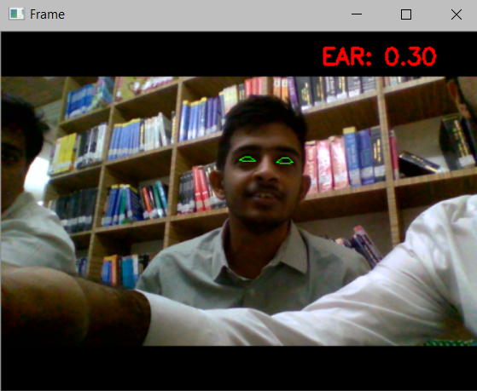
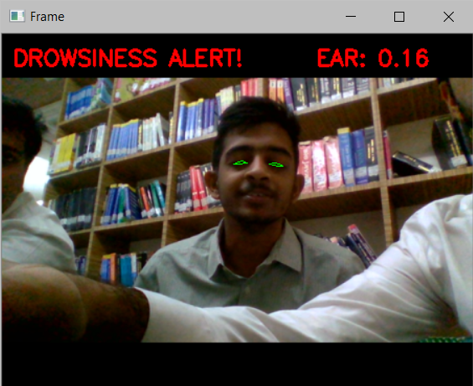
IMPLEMENTATION

Slide 22
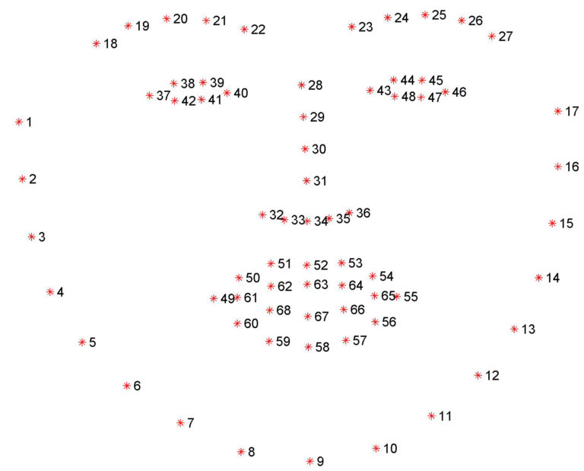
Dataset
Notes:
Insert a map of your country.

Slide 23
FUTURE ACTION PLAN
Advance Lane Detection with Angle of inclination and Perspective Transformation
Compare our trained vehicle detection model with a pre trained model based on local dataset
Extending the project by discovering more problem domains and implementing solutions. For eg: Traffic sign classifier
Implementing real time directives for a vehicle based on alerts and responses from the software
Notes:
Insert a picture of one of the geographic features of your country.

